Slide 1


SMART INDIA HACKATHON 2026
Solar Powered PCM Assisted Portable Milk Chilling Can
Problem Statement ID – SIH26110
Problem Statemen Title - Development of a Low-Cost Light-weight Milk Chilling Can for Small –Scale Dairy Farmers
Theme - Agriculture , Food Tech and Rural Development
PS Category - Hardware
Team ID -
Team Name - CHILLFORGE

Slide 2


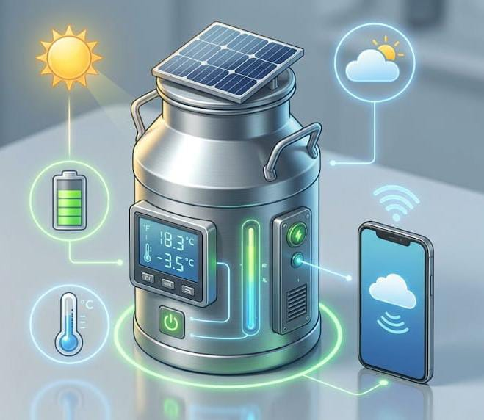
Solar Powered PCM Assisted Portable Milk Chilling Can
Proposed Solution
A portable milk chilling can designed to help farmers keep milk fresh during collection and transportation.
It uses solar energy and a rechargeable battery to power the cooling system.
The system automatically cools the milk when the temperature rises above 4°C.
PCM stores cooling energy, helping the milk stay cool even when active cooling is reduced.
Farmers can check temperature and battery status remotely through an IoT-based system
Auto-Segregation
Smart alerts
Recycling Ready

Slide 3
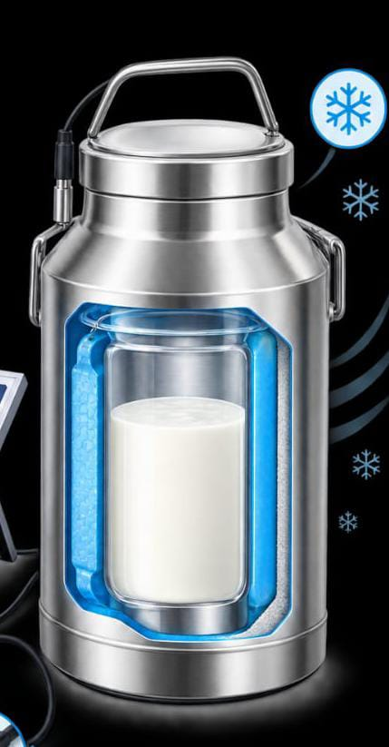
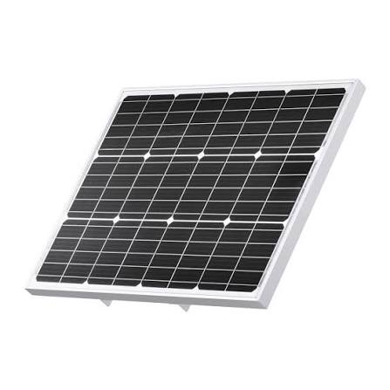

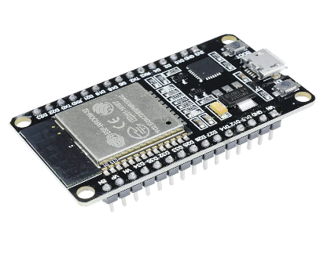
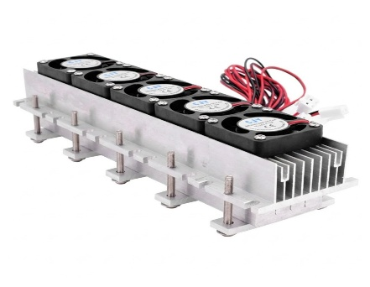
TECHNICAL APPROACH
Technologies:
ESP32,Temperature Sensor , Peltier Module , PCM , Solar Panel , Battery , IoT .
Methodology:
Solar Power Generation
ESP32 Data Acquisition
IoT Monitoring & Alert Delivery
Peltier Cooling
PCM Thermal Storage

Slide 4
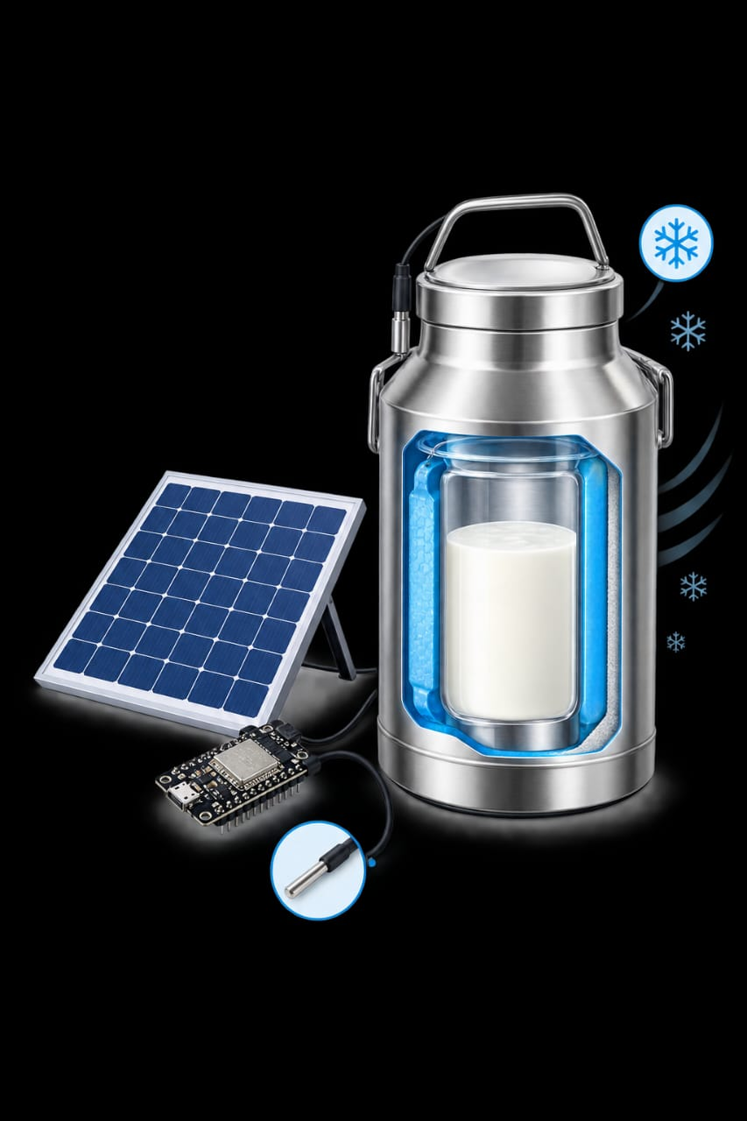
FEASIBILITY AND VIABILITY
Feasibility:
Simple, low-cost , solar-powered and portable.
Challenges:
Maintaining 4°C, Peltier heat, limited battery power.
Solutions:
PCM cooling, heat sink & fan, insulated milk can.

Slide 5



IMPACT AND BENEFITS
Impact :
Reduces milk spoilage during transportation
Helps maintain milk quality
Reduces losses for small-scale farmers
Benefits:
Social | Supports farmer with better milk handling
Environmental | Uses renewable solar energy
Economic | Reduces milk wastage & income loss

Slide 6
RESEARCH AND REFERENCES
Review on Thermal Energy Storage with Phase Change Materials and Applications https://www.researchgate.net/publication/222427268_Review_on_Thermal_Energy_Storage_with_Phase_Change_Materials_and_Applications
Effects of Milk Preservation using the Lactoperoxidase System https://www.researchgate.net/publication/43554785_Effects_of_milk_preservation_using_the_lactoperoxidase_system_on_processed_yoghurt_and_cheese_quality
IoT Based Smart Agriculture System Using ESP32 https://www.researchgate.net/publication/382701895_IoT_Based_Smart_Agriculture_System_Using_ESP32
THANK YOU

